Slide 1
Financial analysis

Slide 2
introduction
The Finance Analytics Tableau Project focuses on analyzing key financial metrics to provide deep insights into the financial health of a company. By examining revenue trends, expenses, and financial ratios, the project aims to support data-driven decision-making processes. This Tableau dashboard will offer visualized financial KPIs and performance indicators, allowing stakeholders to track financial performance over time, compare actual performance against budgets, and ensure financial sustainability. The project is designed to be user-friendly, offering clear, actionable insights into company finances for improved planning and strategy.

Slide 3
oBJECTIVEs
Analyze Revenue and Expenses:
Examine how revenue and expenses evolve over time to identify patterns and trends that
impact the financial stability of the company.
Monitor Key Financial Ratios:
Track essential financial ratios, including profit margins, return on assets (ROA),
and debt-to-equity ratio to measure the company's financial efficiency and leverage.
Track Budget vs. Actual Performance:
Compare the actual financial performance against the budgeted projections to identify gaps
and areas for improvement.
Visualize Key Financial Metrics:
Display important financial performance indicators (KPIs) such as gross sales, cost of goods sold (COGS),
profit, and more, enabling quicker decisions on company performance.

Slide 4
Main kpiS
Total Revenue
2. Gross Profit Margin
3. Operating Expenses
4. Net Profit Margin
5. Cost of Goods Sold (COGS)
6. Return on Assets (ROA)
7. Debt-to-Equity Ratio
8. Sales Growth Rate
9. Profit per Unit Sold
10. Discounts Given

Slide 5
TABLEAU DASHBOARD
This Tableau dashboard provides a detailed analysis of the company's financial performance based on key metrics such as revenue, profit, expenses, and sales trends. Using data segmented by product, country, and discount bands, the dashboard visualizes insights into gross sales, costs, and profitability across different regions and time periods. The interactive visualizations enable decision-makers to track performance indicators like gross profit margin, return on assets, and debt-to-equity ratio, facilitating data-driven strategies for optimizing financial health and growth.

Slide 6
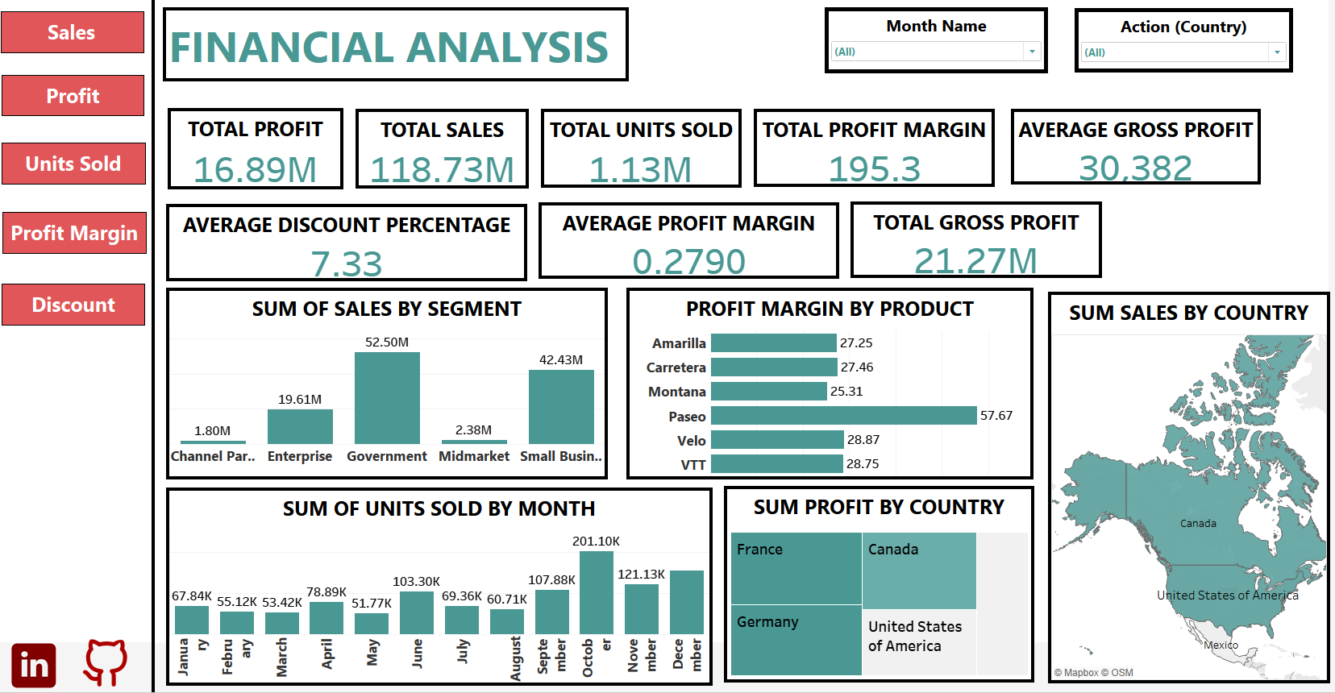

Slide 7
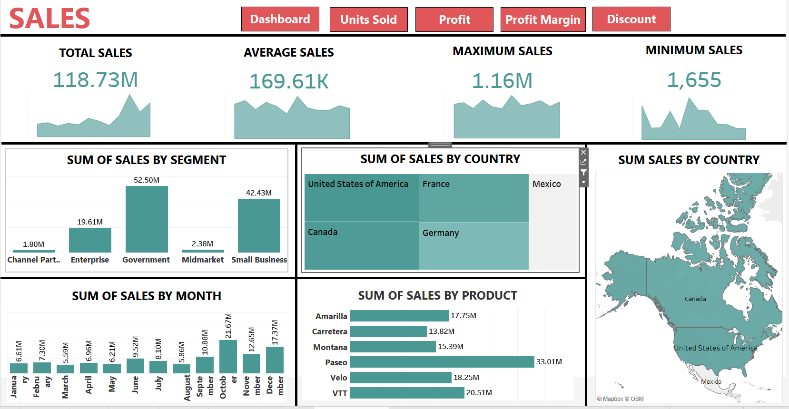

Slide 8
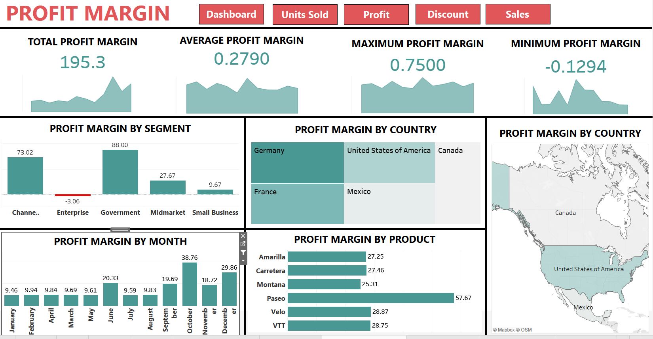

Slide 9
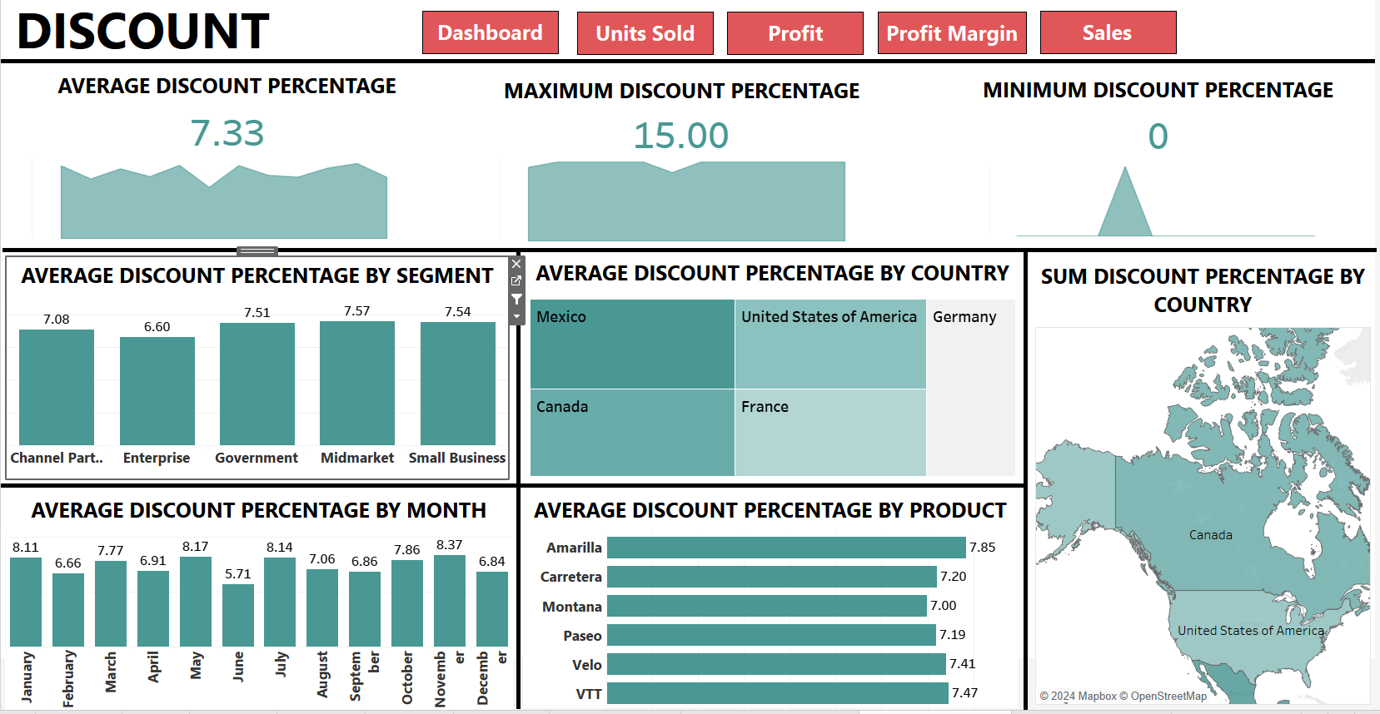

Slide 10
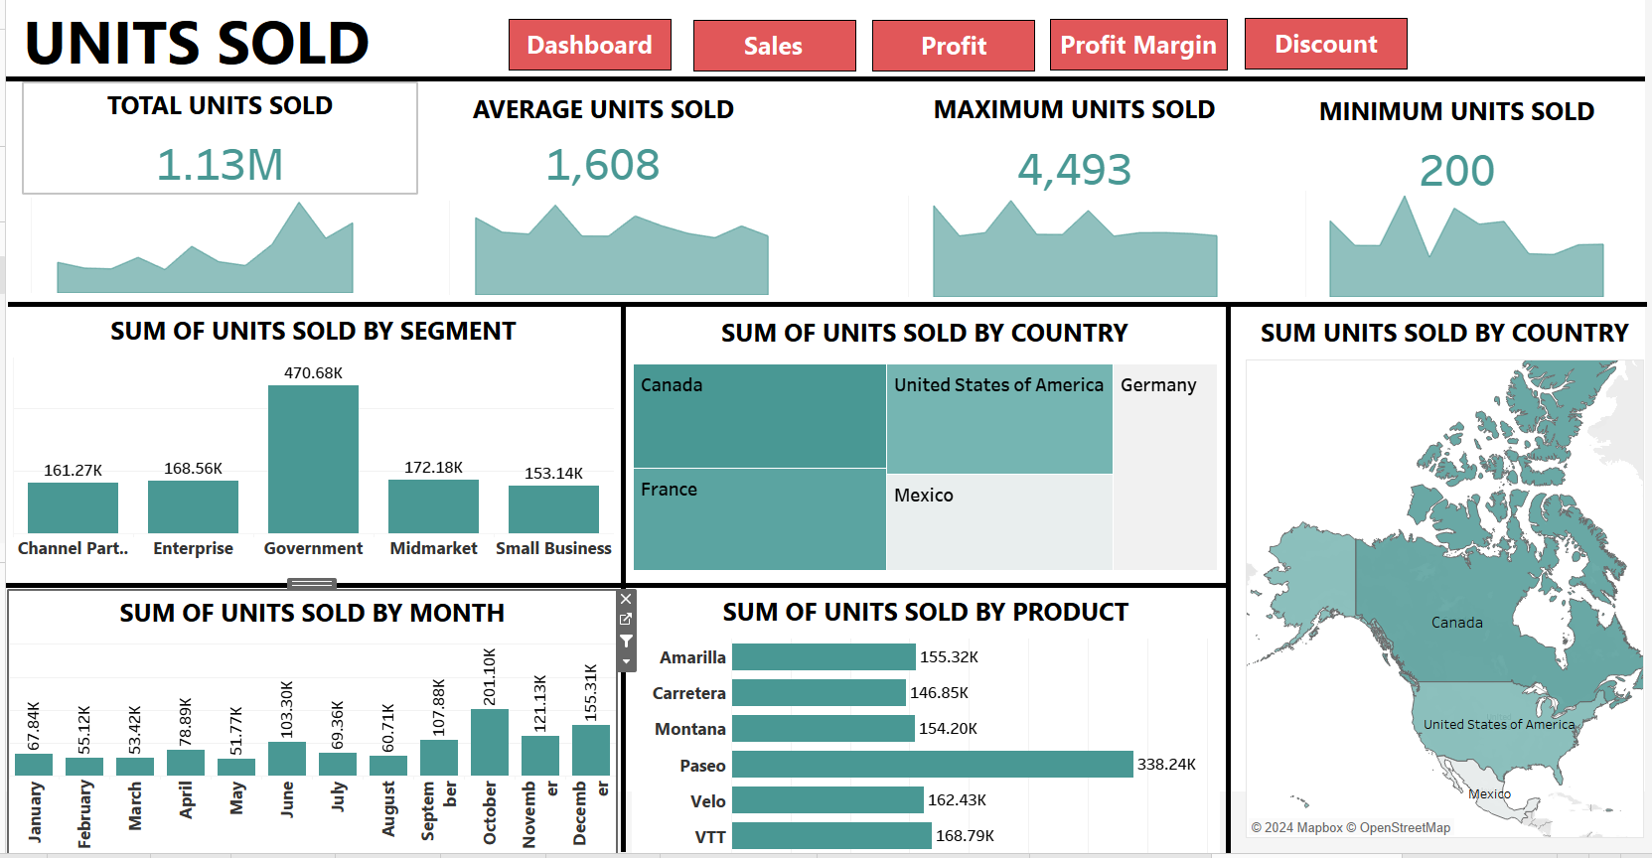

Slide 11
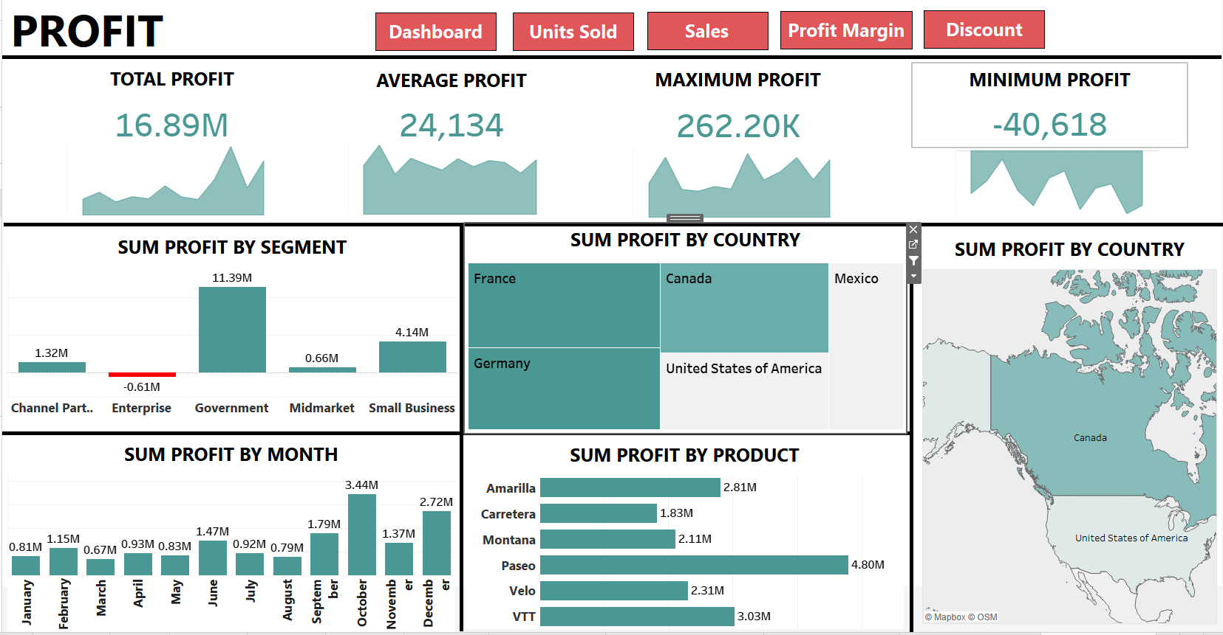

Slide 12
POWER BI DASHBOARD
This Power BI dashboard offers a comprehensive view of the company’s financial performance by visualizing key metrics such as revenue, expenses, profit, and sales trends. The dataset, segmented by product, country, and discount bands, enables detailed analysis of gross sales, COGS, and profit margins across various regions and time frames. The interactive features in Power BI allow stakeholders to monitor important financial KPIs, including gross profit margin, return on assets, and debt-to-equity ratio, supporting informed decision-making and strategic planning to enhance financial efficiency and growth.

Slide 13
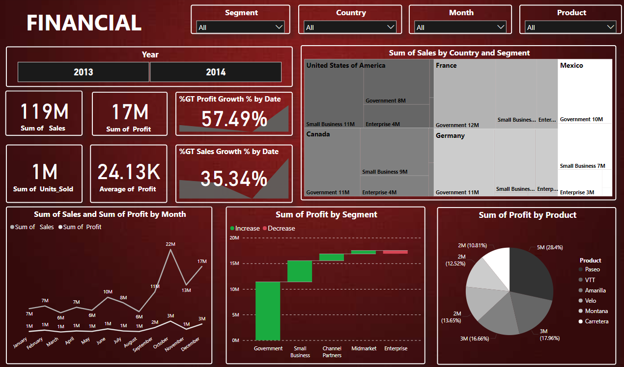

Slide 14
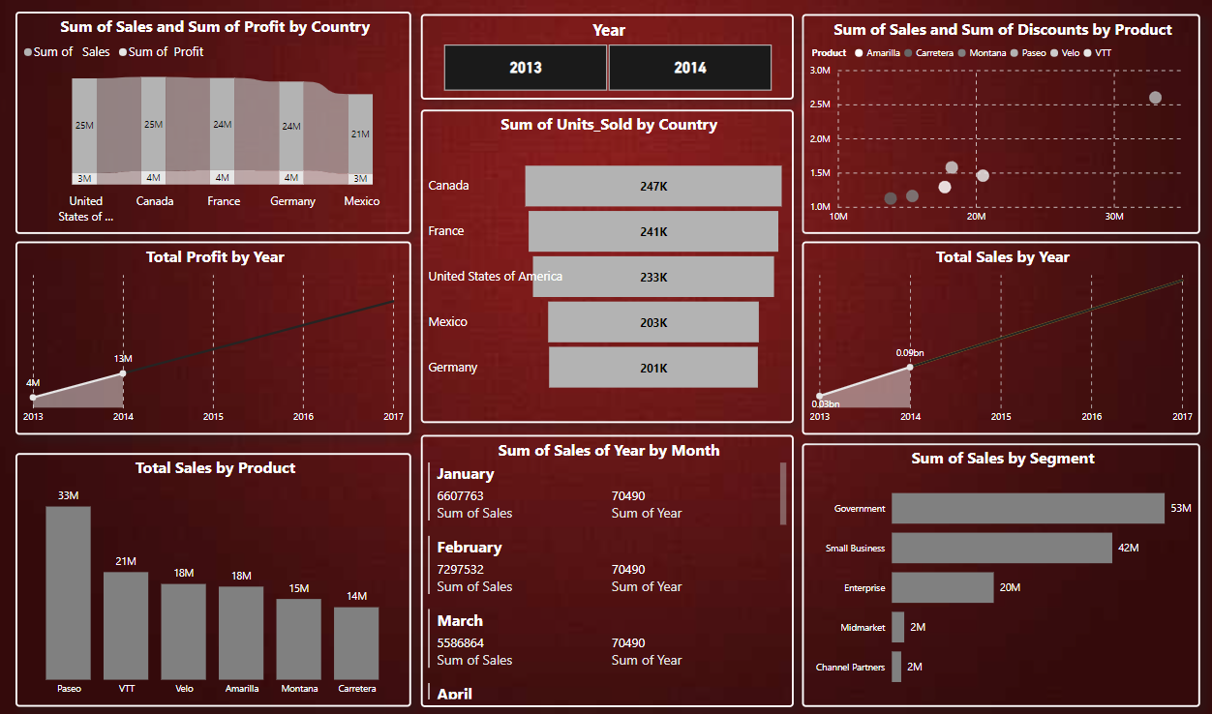

Slide 15
PYTHON
This Python analysis uses the provided financial dataset to generate comprehensive insights into the company's performance. By leveraging libraries like Pandas, Matplotlib, and Seaborn, we explore key metrics such as revenue, expenses, profit, and sales trends. The data is segmented by product, country, and time, allowing for detailed analysis of gross sales, costs, and profitability. Through visualizations and statistical analysis, we can track key financial KPIs such as gross profit margin, return on assets, and debt-to-equity ratio, empowering data-driven decision-making for optimizing financial performance.

Slide 16
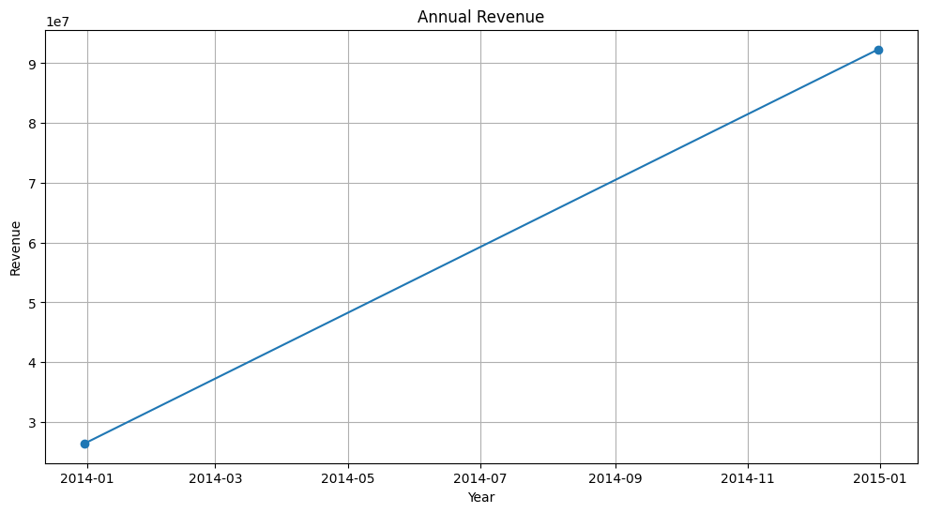
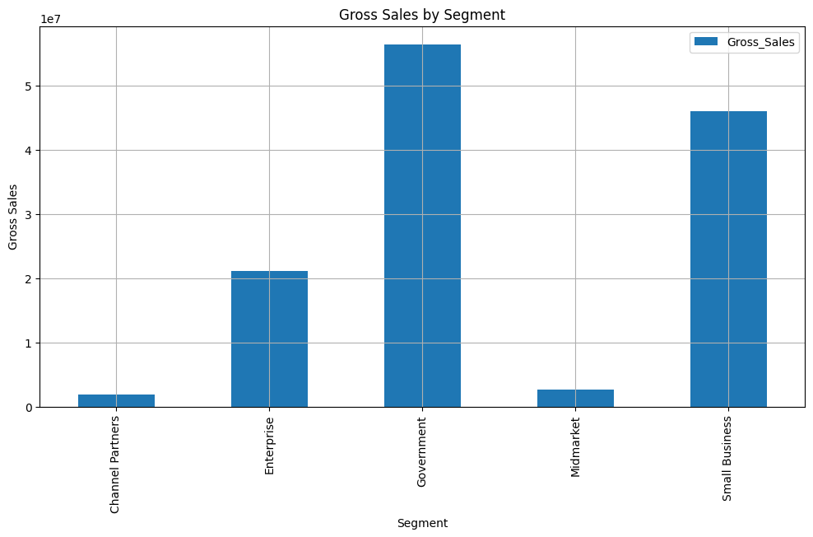
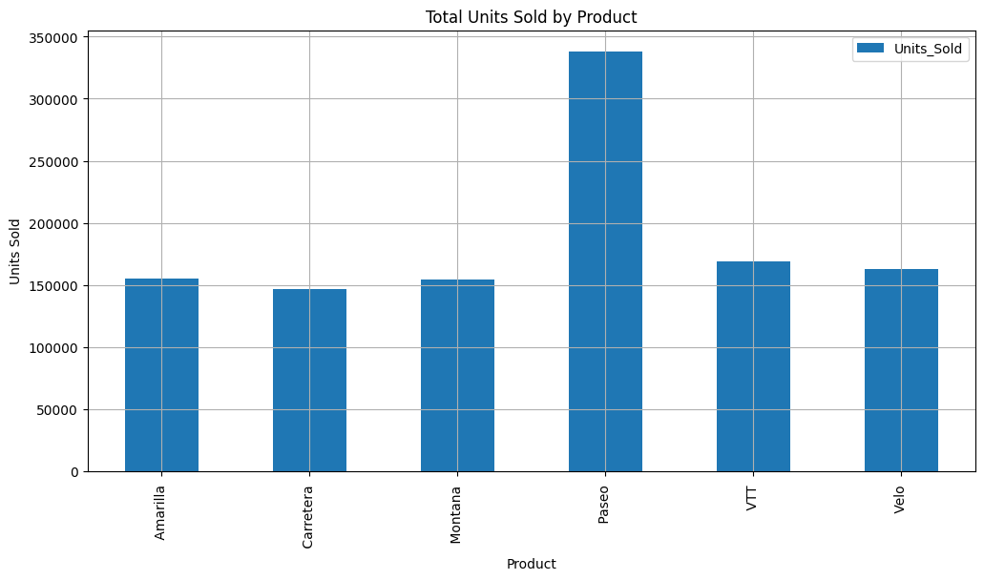
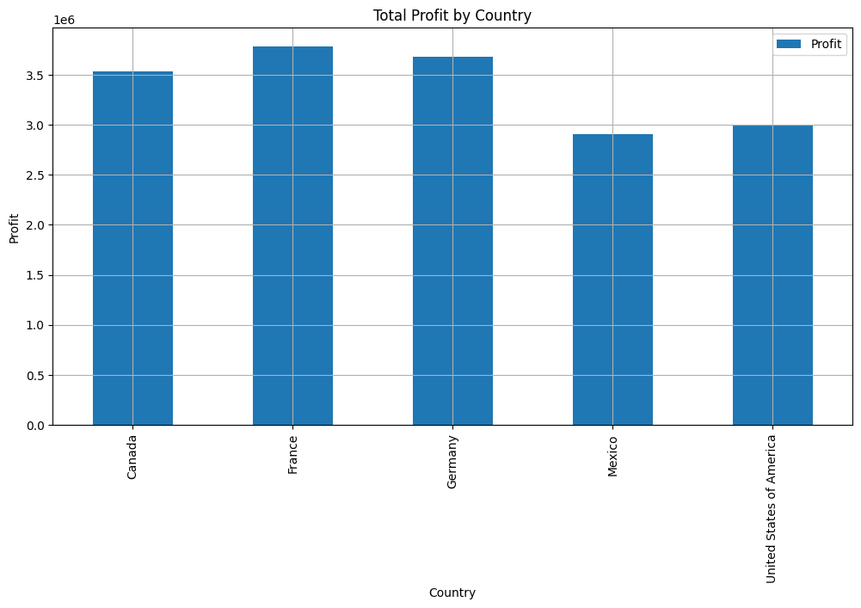

Slide 17
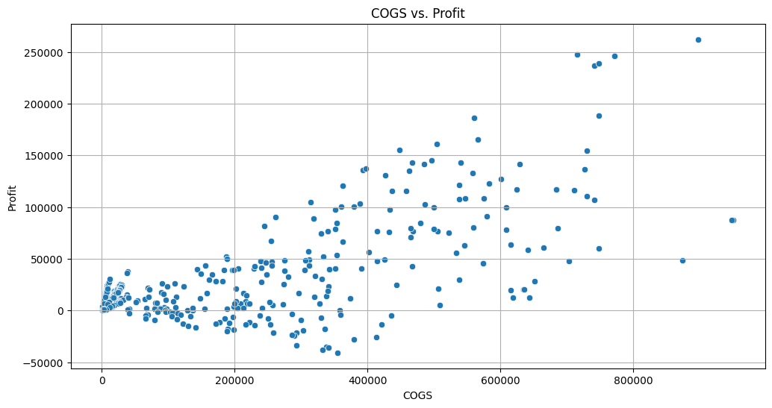
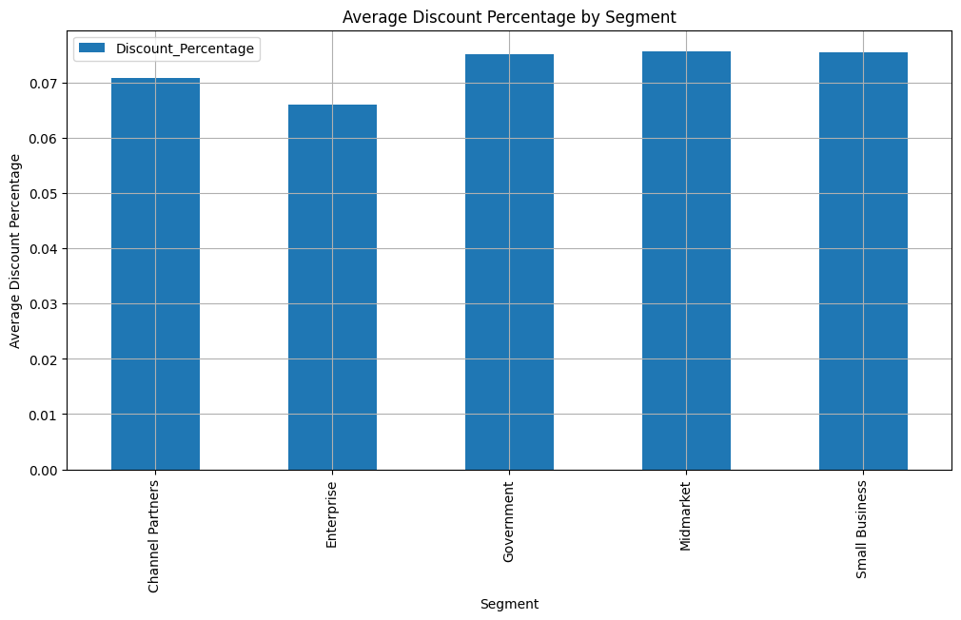
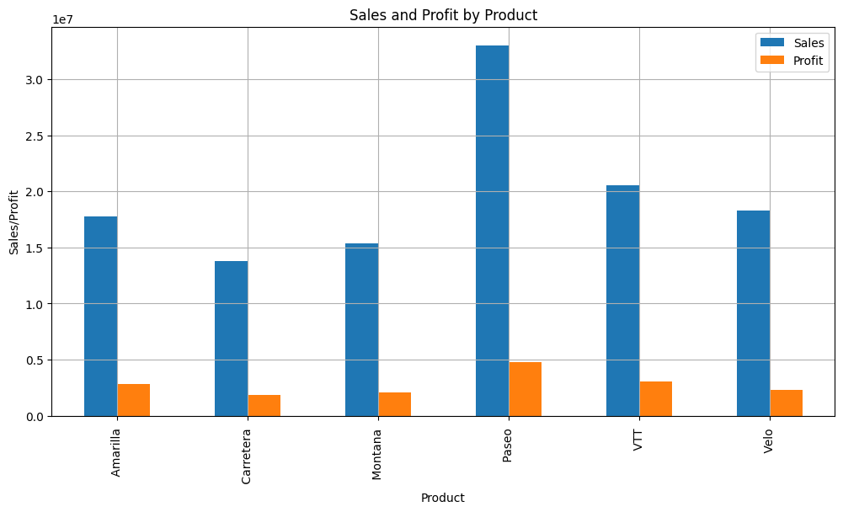
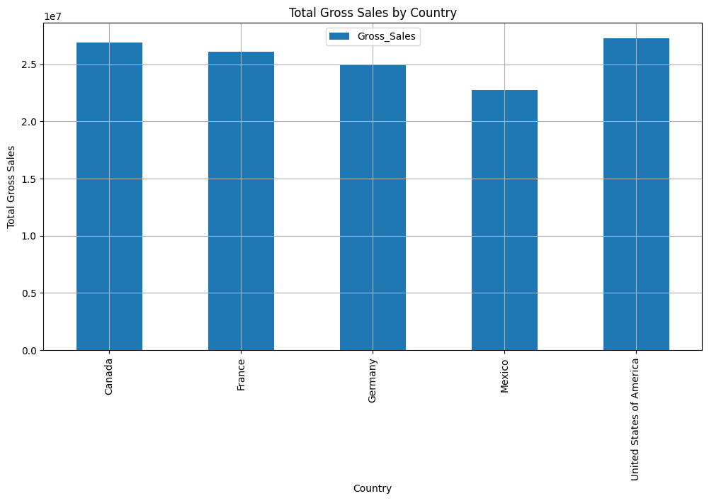

Slide 18
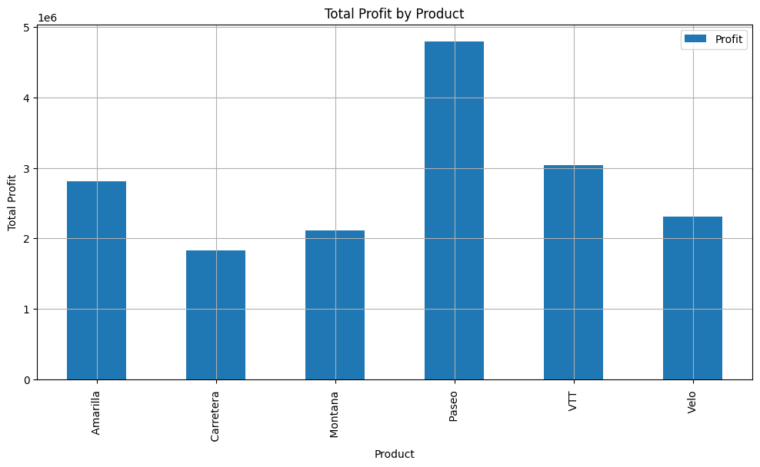
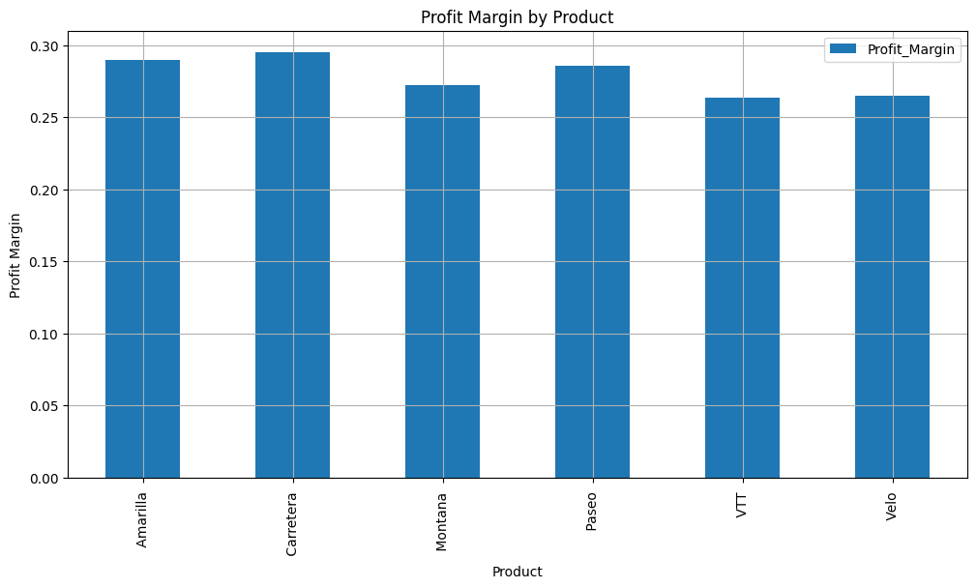
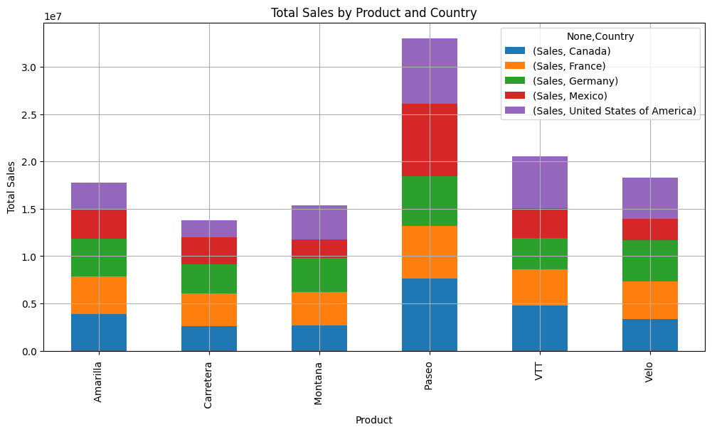
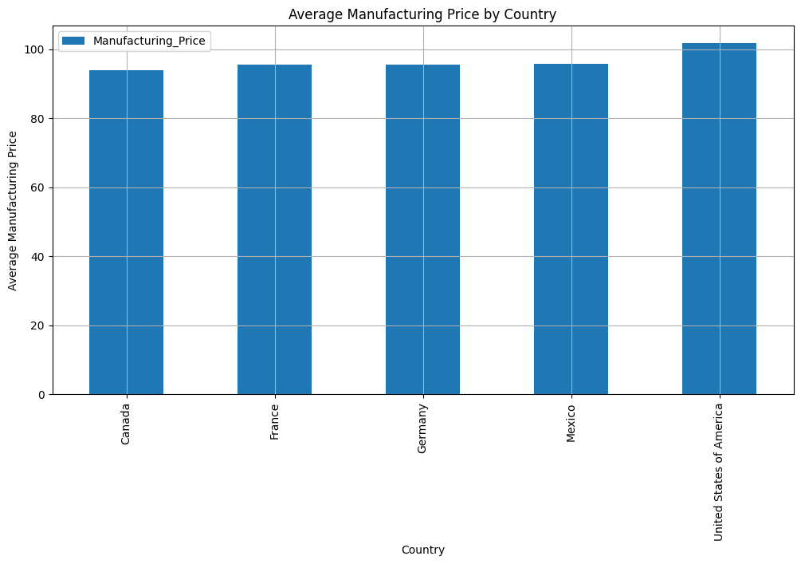

Slide 19
MY SQL
Developed a financial analytics solution using SQL to preprocess and analyze company financial data. The project involved querying datasets with columns such as Segment, Country, Product, Units Sold, Sale Price, COGS, and Profit. I implemented advanced SQL queries to track key financial metrics, including Sales Trends, Profitability, Cost of Goods Sold (COGS), and Discounts across various segments. These insights were further visualized in Tableau to support data-driven decision-making.

Slide 20
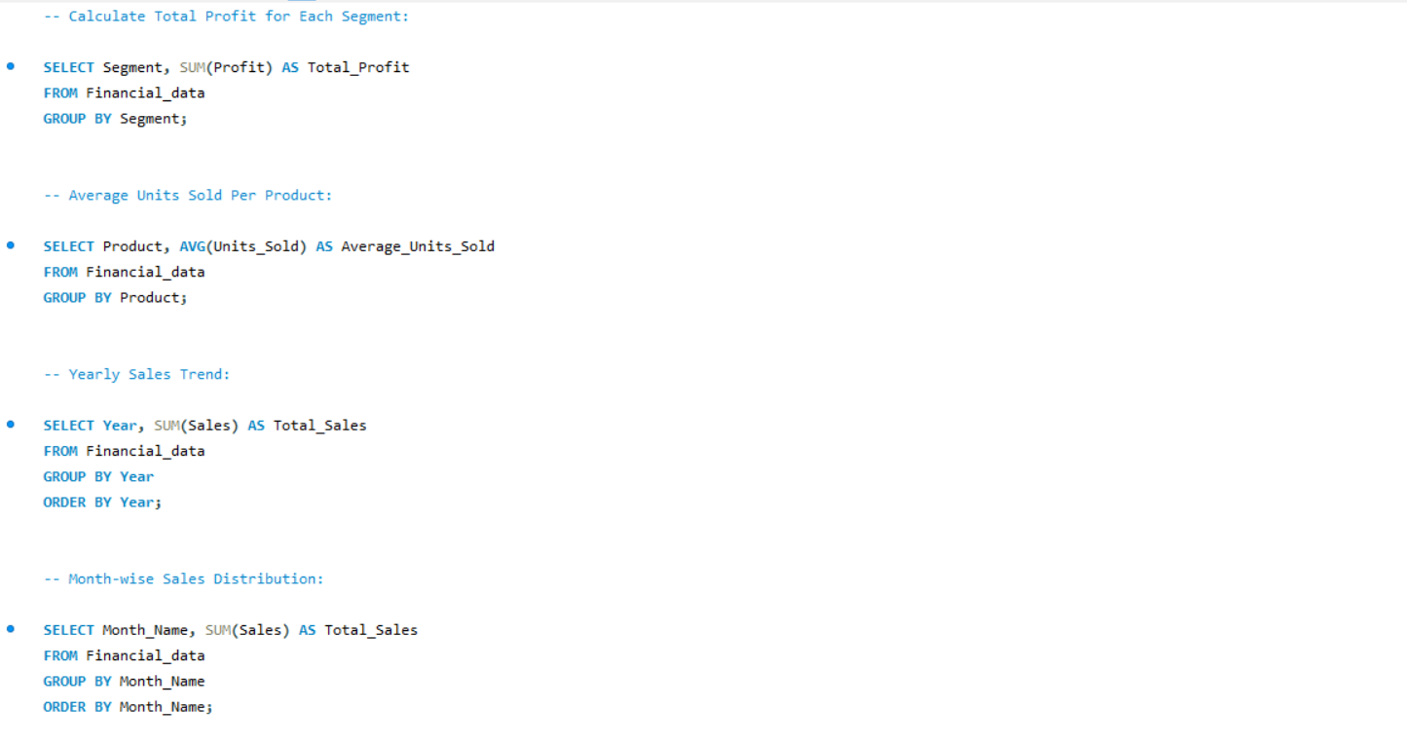

Slide 21
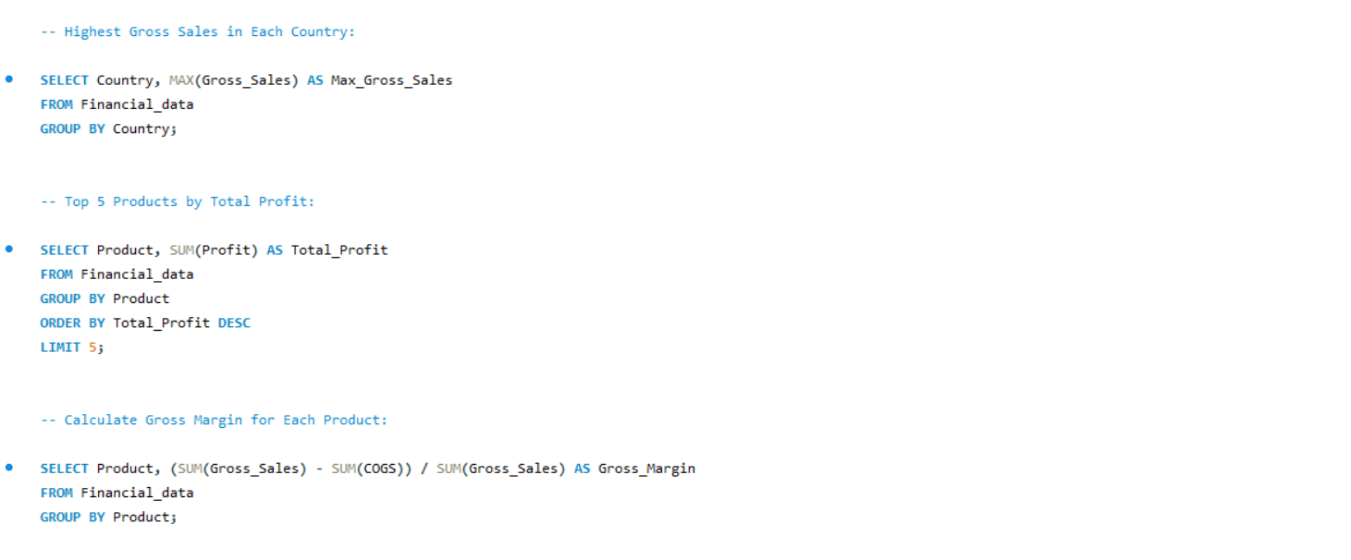

Slide 22
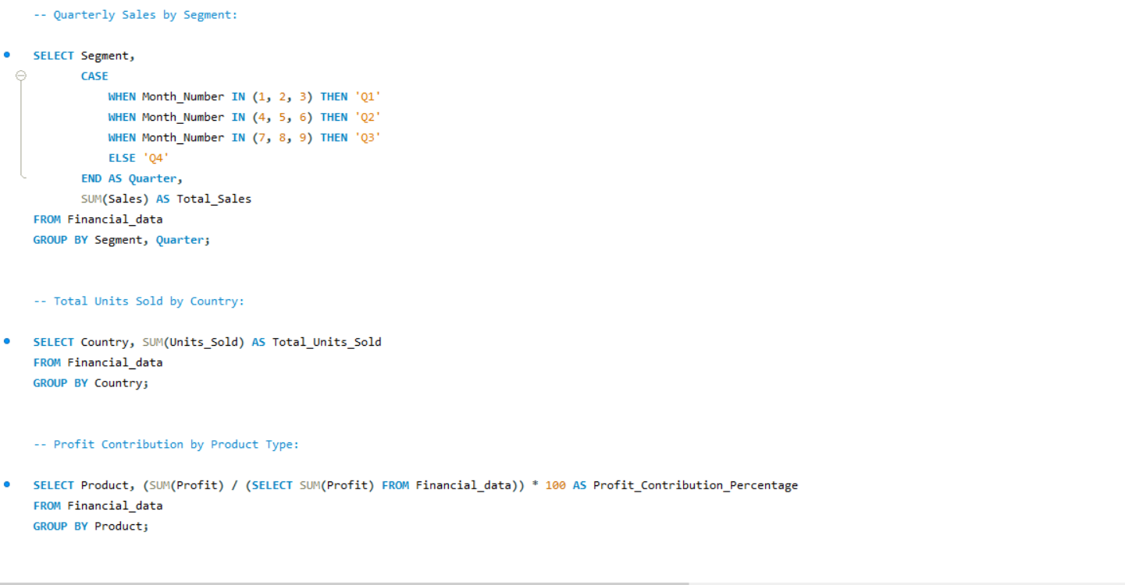

Slide 23
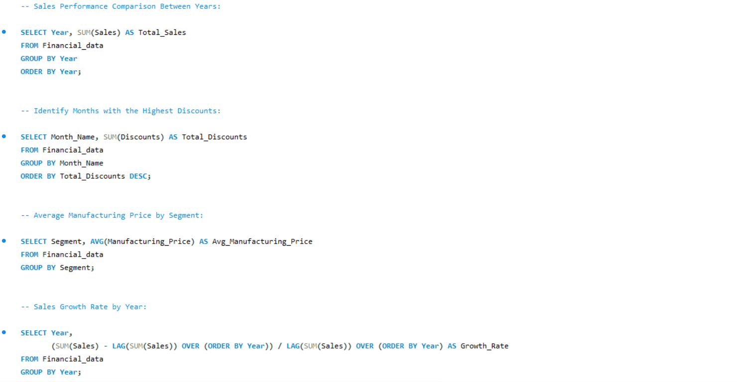

Slide 24
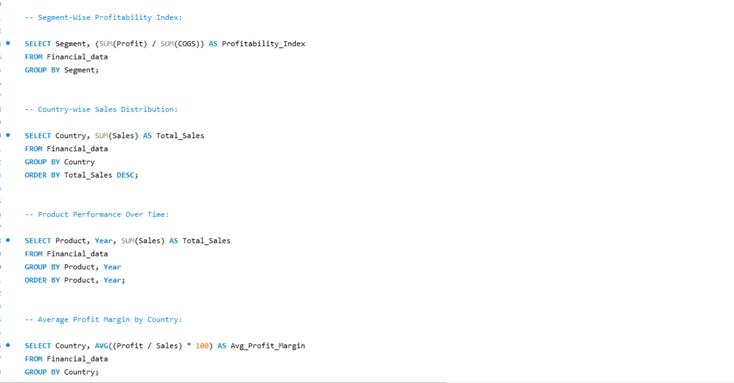

Slide 26
conclusion
The analysis of the company's financial data using Python and Tableau provides valuable insights into its overall financial health. Key performance indicators like total revenue, gross profit margin, and return on assets highlight the company's efficiency and profitability across various segments and regions. By tracking expenses, sales trends, and financial ratios, we can identify areas for cost optimization and revenue growth. The combination of Python's robust data analysis and Tableau's interactive visualizations allows stakeholders to make informed, data-driven decisions to improve financial strategies and drive long-term success.

Slide 27


VISIT FOR DETAILED PROJECT
Click on linkedin logo to visit my Profile
Click on Github logo to visit the portfolio of the project

